Slide 1
CCE: Ramadan Iftar Drive for the Needy
Team:
Saahil Ghulam Mohammad (24K-0570) [Leader]
Hamza Shahid (24K-0869)
BCS-2D
Civics and Community Engagement

Slide 2
Introduction
Our Iftar Drive aimed to provide nutritious meals to underprivileged individuals during Ramadan.
Objectives:
Distribute Iftar meals to fasting individuals and families in need.
Promote community solidarity and empathy.
Raise awareness about food insecurity during Ramadan.

Slide 3
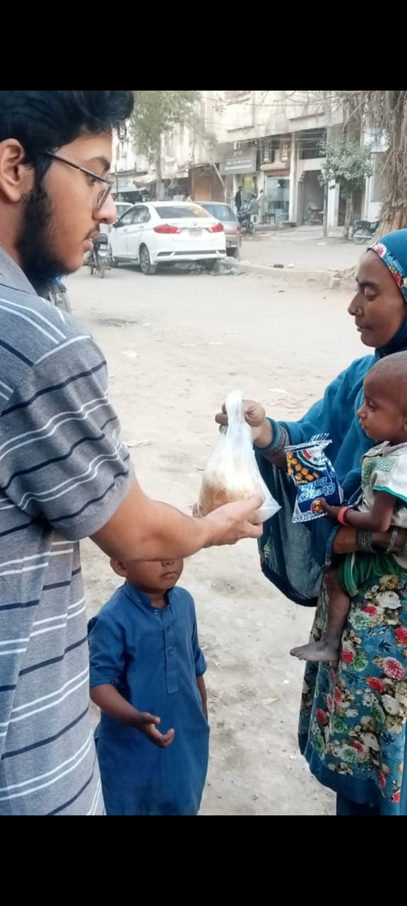
SDGs Addressed
SDG 1: No Poverty
Supporting vulnerable communities to reduce socioeconomic disparities.
SDG 2: Zero Hunger
Ensuring access to nutritious meals for those facing food insecurity.
SDG 10: Reduced Inequalities
Bridging gaps by serving marginalized groups during Ramadan.

Slide 4
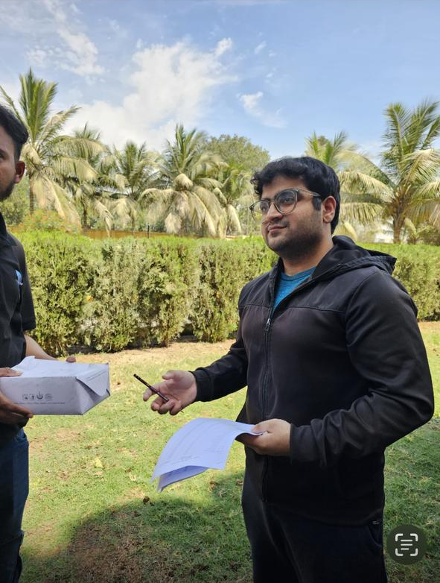
Visit Highlights
Meal Preparation: Partnered with local kitchens to prepare hygienic, halal meal packages (dates, water, snacks, main dishes).
Distribution Strategy:
Set up Iftar stations near mosques.
Delivered meals to homes of identified families.
Community Engagement: Educated locals on the importance of charity and shared Ramadan values.

Slide 5
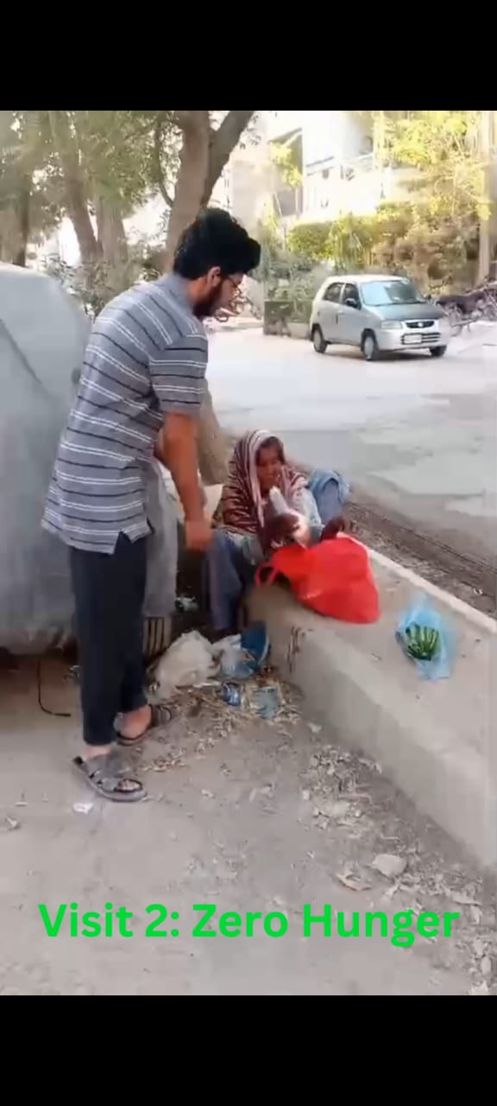
Key Takeaways
Compassion in Action: The power of collective generosity during Ramadan.
Sustainable Impact: Addressing hunger through structured initiatives.
Unity & Faith: Strengthening community bonds through shared values.

Slide 6
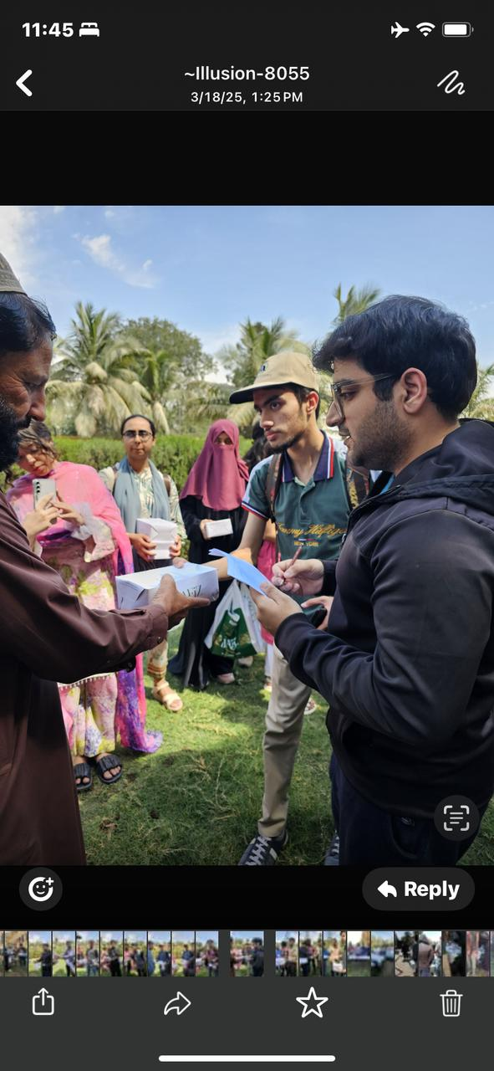
Future Contributions
Annual Ramadan Drives: Expand meal distribution to more neighborhoods.
Partnerships: Collaborate with NGOs and mosques for wider reach.
Awareness Campaigns: Highlight food insecurity challenges year-round.

Slide 7
Conclusion
Our Iftar Drive reinforced the spirit of Ramadan – kindness, empathy, and unity. We aim to sustain this effort and inspire lasting change in our community.

Slide 8
Thank You!
- By Saahil & Hamza

